Slide 1

TECH VISION
Mathias Leach Glintborg 戈霖 Global Development Manager
Notes:
Name
Project developed by ONCHAIN
Background → ONCHAIN used DNA for identity chain in GuiYang
To do business real business; money and identity/trust (real-world) → Ontology provide identity to blockchains
NEO → DaHongFei → Tomorrow
Not trying to solve a particular problem → build infrastructure for applications that try to solve problem
Success
Agenda

Slide 2
What is Ontology?
Public blockchains with new architecture
&
Public platform for a distributed trust ecosystem
Notes:
New generation → Chain network (multiple-chains)
Cross-industry → modules and protocols
What is Ontology not? It’s not NEO
Ontology use NEO contract system

Slide 3
Public blockchains with new architecture

Slide 4
Public blockchain
Successes & Challenges
Notes:
Challenges:
Deep communization for compliance and compliance/regulations/law!
Scalability (single chain) e.g. dApps
Digital assets

Slide 5
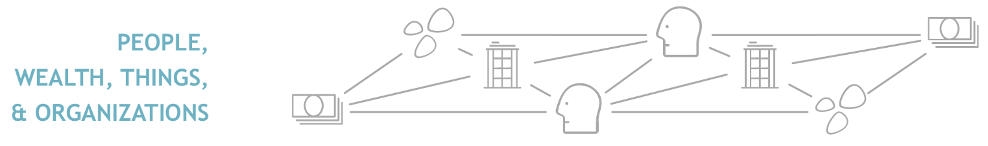
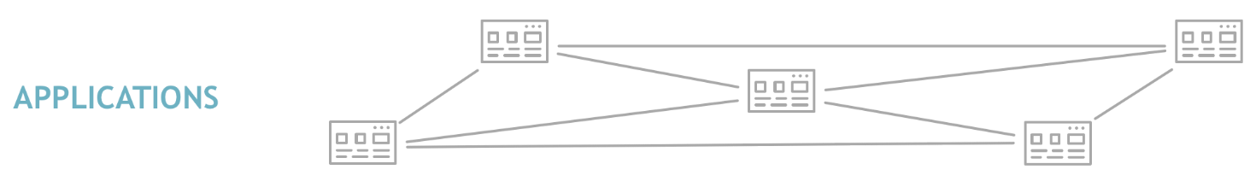
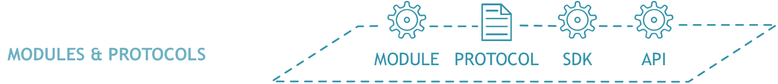
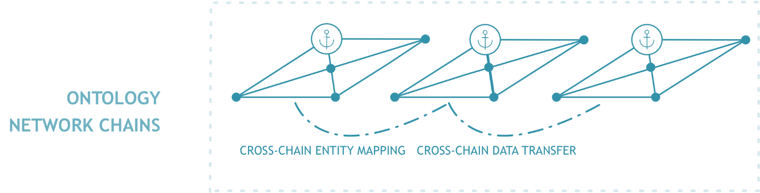
Notes:
Cross-industry

Slide 6
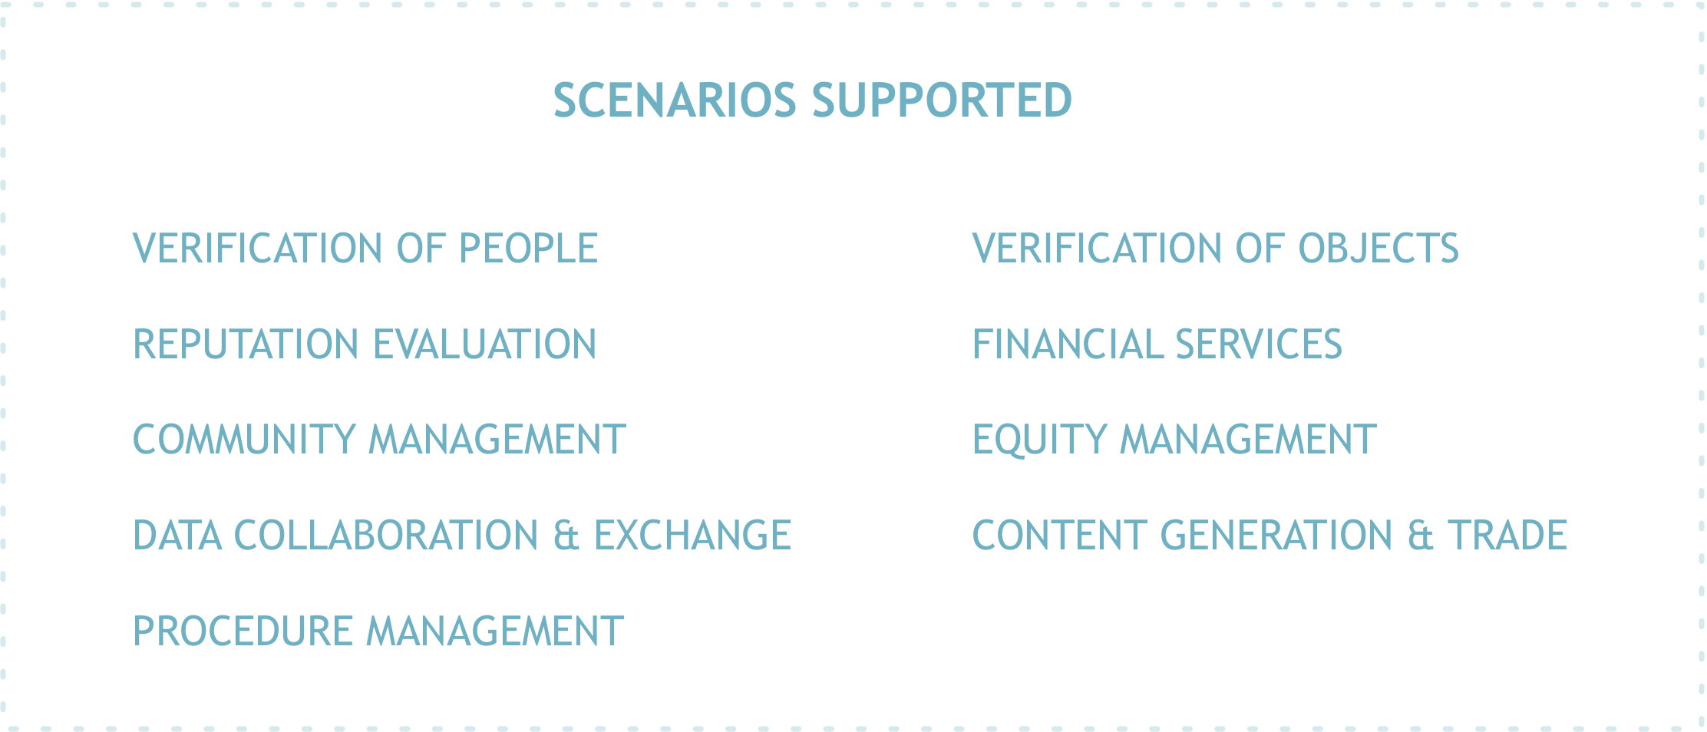
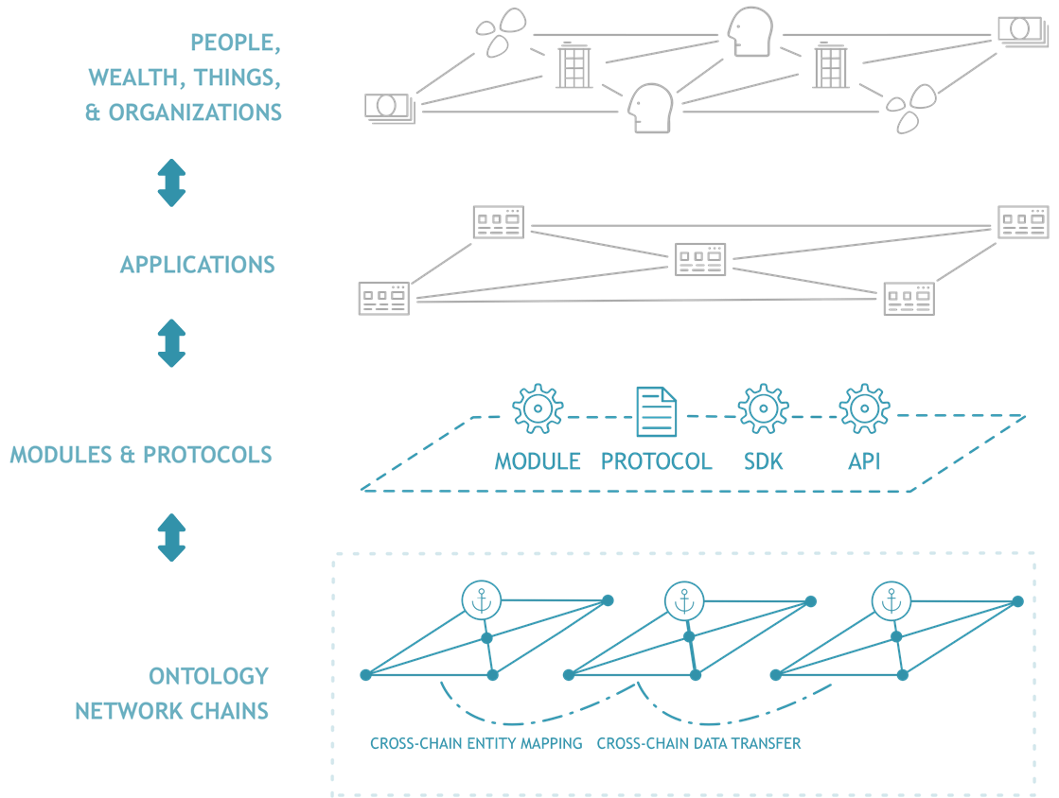

Slide 7
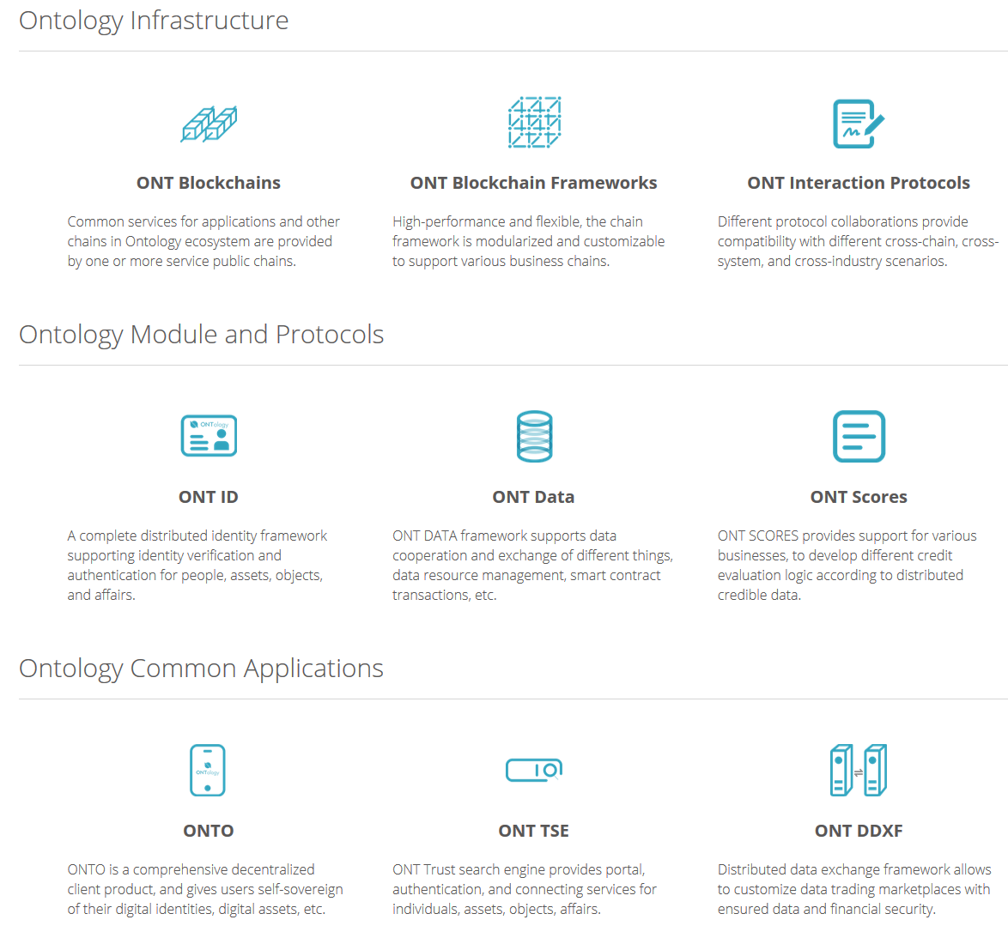
First phase

Slide 8
Distributed trust ecosystem
Notes:
Core of Ontology

Slide 9
Three dimensions of trust
Trust through legal systems
Trust through technology
Trust through communities
Notes:
Trust in technology: Digital signatures, biometrics → Now blockchain/DLT
Trust through legal system: Ownership (house). Legal validity and support. Verify and authenticate
Trust through communities: Home town (people to people), Facebook or WeChat (repurartion), Ranking for online retailers (peer)

Slide 10
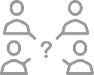







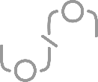






Issues in current trust network
Fragmented sources of trust
Missing role of
the individual
Emergence of new
sources of trust
Data management
monopolization
Data fragmentation
Inaccurate identity
verification
Security issues in
the Internet of Things
Data exchange security issues
Trust issues in
collaborative systems
Transparency issues in
Equity management
Weak community
management
Identifying false
information
Weak reputation systems
Making charitable
donations
More barriers...
Notes:
Weak connection between trust dimensions
Fragmented
Weak reputation

Slide 11
Building a network that integrates the fragmented industry is needed to build a true and complete trust system
Notes:
NEED
Issues → Ontology. Multi-source → Build trust through the distributed trust ecosystem

Slide 12
Ontology vision
Ontology as connector and provider fundamental infrastructure and tools
Best teams from the industry to develop the trust ecosystem
Notes:
Best teams (organizations and people) are out in the industry, not in the blockchain industry
Ontology is easy to tap in

Slide 13
Applicable scenarios
Wealth management
Fraud detection
Finance
Insurance
Trading
Derivatives trading
Claims filing
Telematics
Collateral management
Supply chain finance
Claim processing
Digital authentication
Sharing economy
Food supply chain tracking
Software development
Medicine
Consumer
More…
Media
IoT
Supply chain
Shipping and logistics management
Asset titles
Pharmaceutical tracking
Government

Slide 14
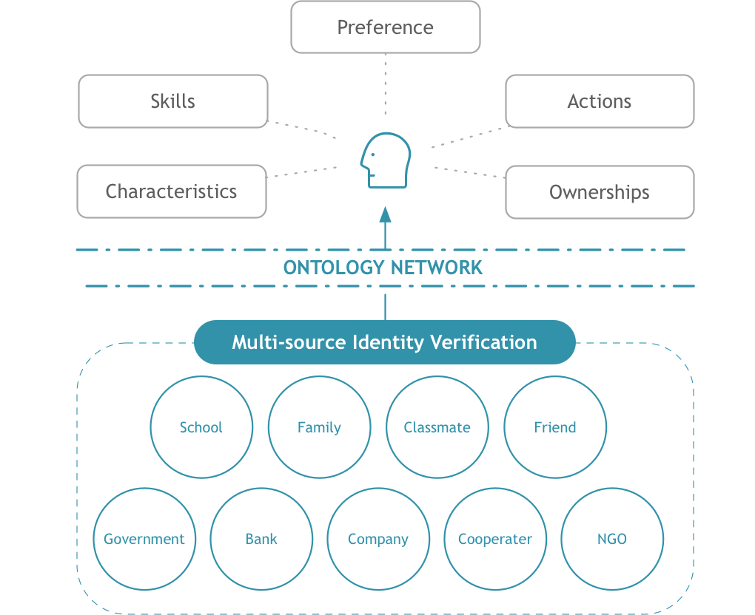
Multi-source identity system for people
Multi-source identity authentication
Comprehensive personal profiles
Data tracking
1
Notes:
Identity is not online passport and government
Also school, family, bank.
Everyone can be the trust source
Multi-source trust verification
E.g. experience → professional and educational → Apply for job or financial service
Same idear to objects → House and car

Slide 15
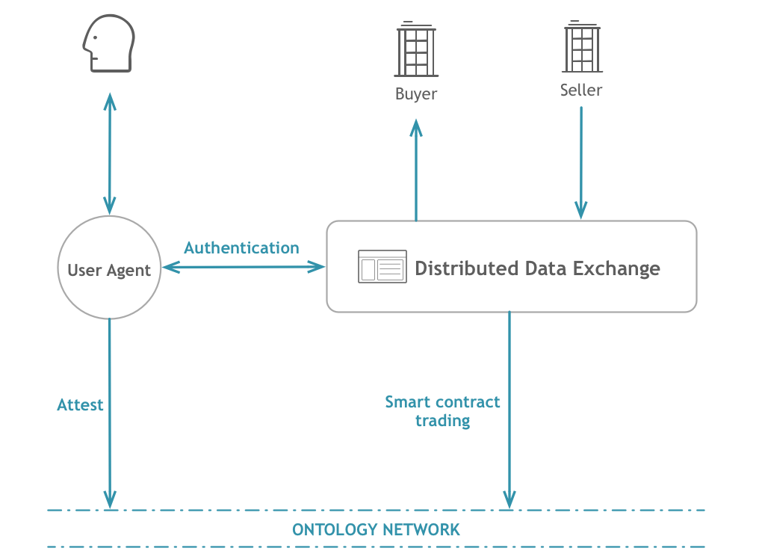
Distributed data exchange
P2P data exchange
Participant authorization
Data traceability
2
Notes:
Big Data age → Data is the new gold e.g. AI algorithm training
People want share, because it’s lost when share. Enable people to be in charge of their own data! Only share calculations.
GDPR

Slide 16
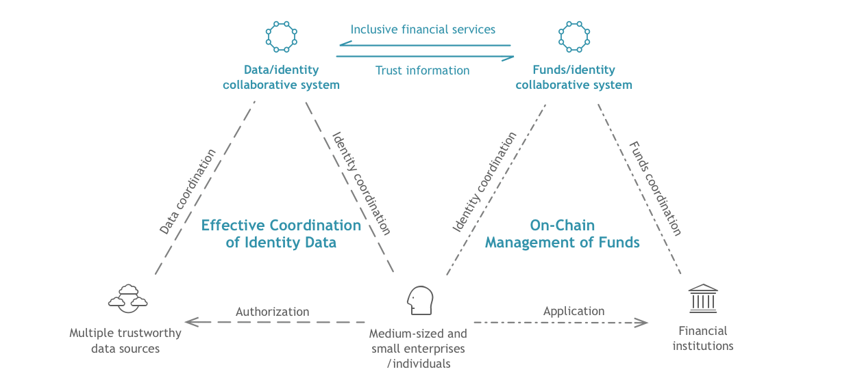
Decentralized inclusive financial services
Role changing
Risk reduction
Fair interest rates
3
Notes:
Expensive to do risk control → Expensive services
Own risk control → turn the role

Slide 17
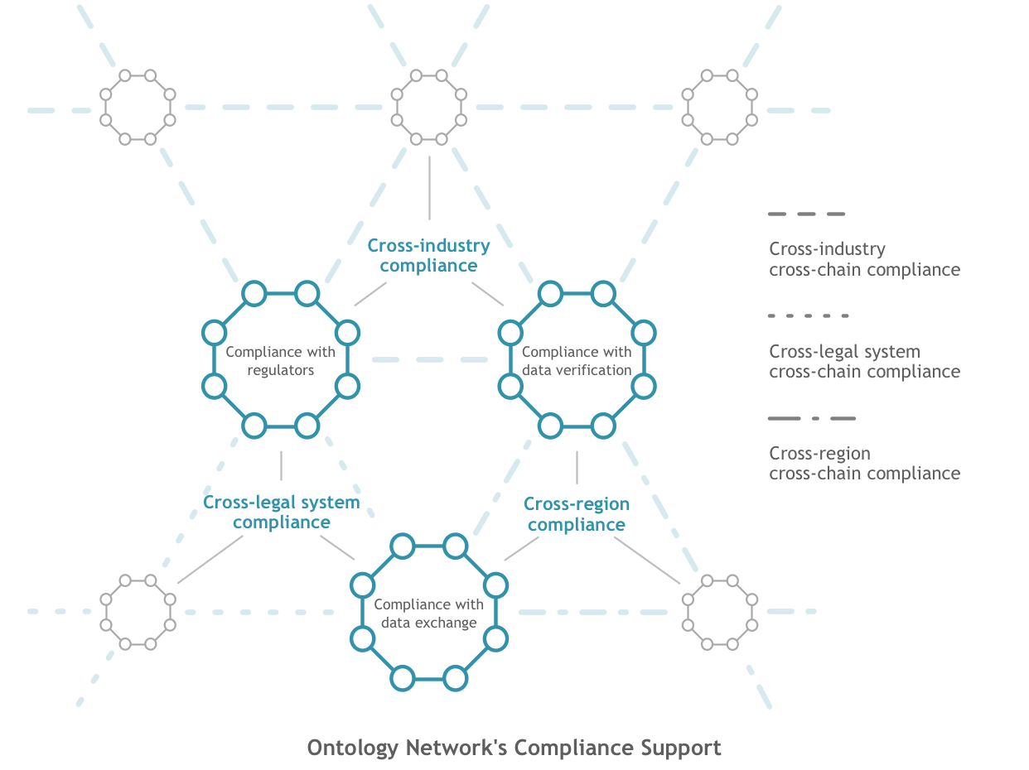
Compliance
Specific regional chain rules
Protocol compliance
Survey and audit mechanisms
Cross region/Industry/legal system
Notes:
Blockchain break the rules. Different industries with different compliance rules and countries with different laws. How to connect that to the real-world to the digital world?
Ontology support that by:
Ontology don’t store personal data on the Ontology network
Only mapping and indexing
Different chains support different governance models to meet requirements

Slide 18
ont.io
THANK YOU
Notes:
P.1 标题页

Slide 19
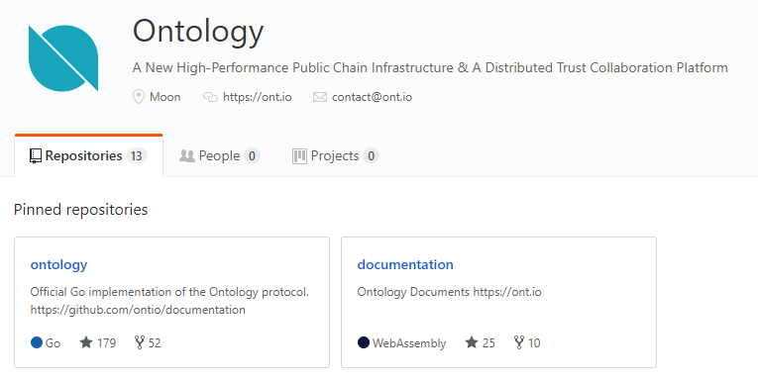
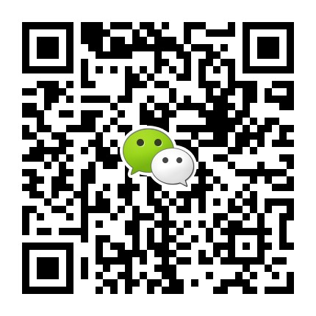
ONT.IO
Mathias Leach Glintborg 戈霖
Global Development Manager
MathiasGlintborg@ont.io
MathiasGlintborg@onchain.com
https://github.com/ontio

Slide 20
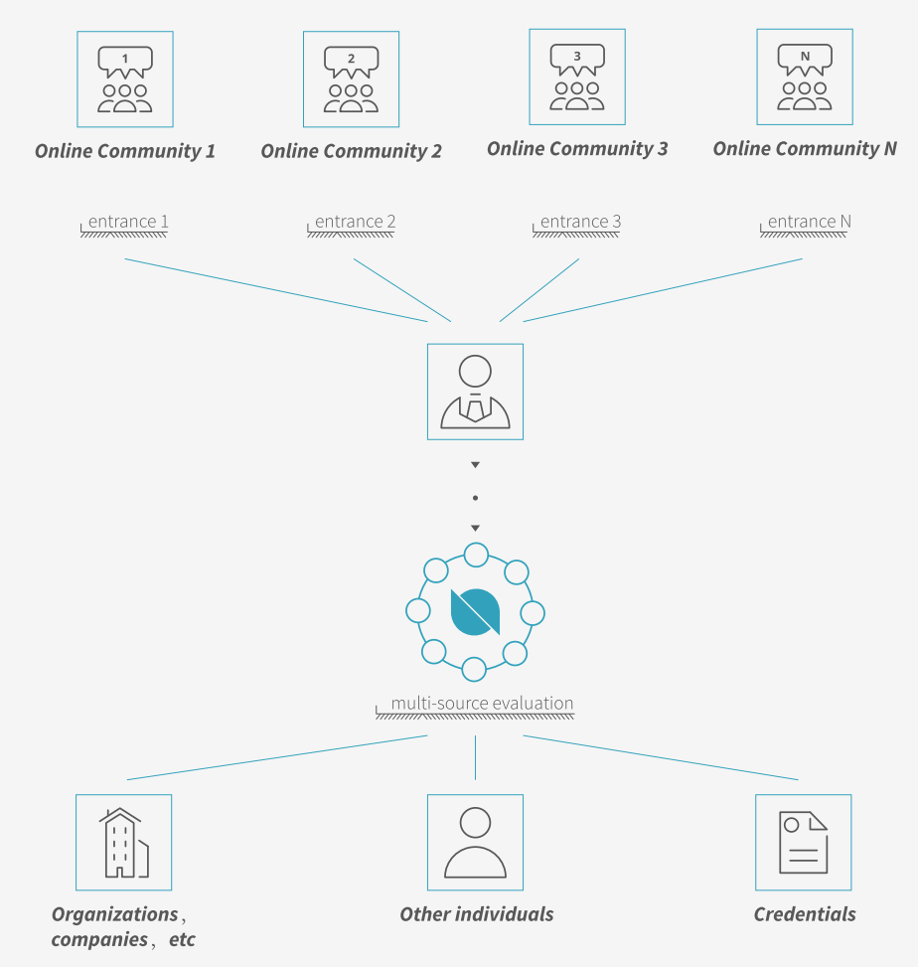
Build your
Distributed Communities
on
Ontology

Slide 21
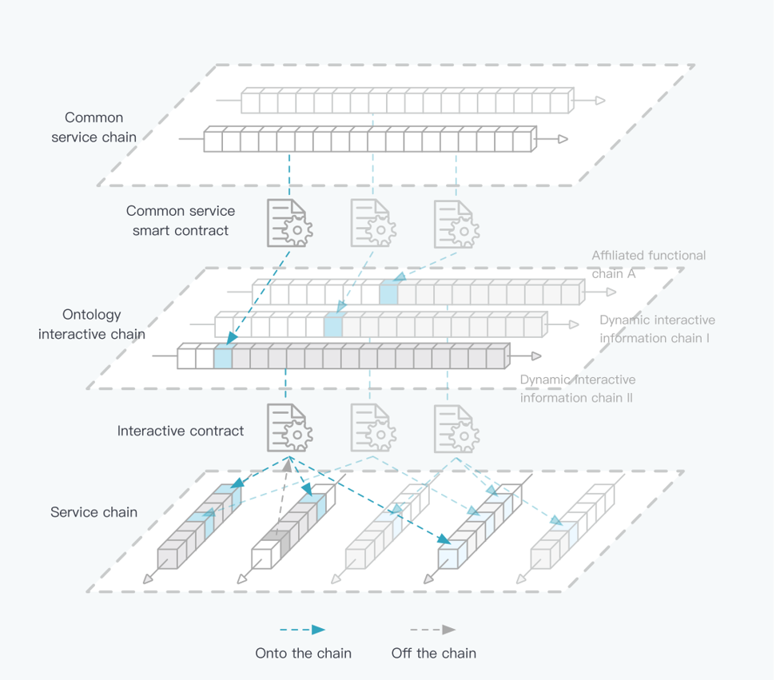
Ontology
Chain-Network Architecture

Slide 22
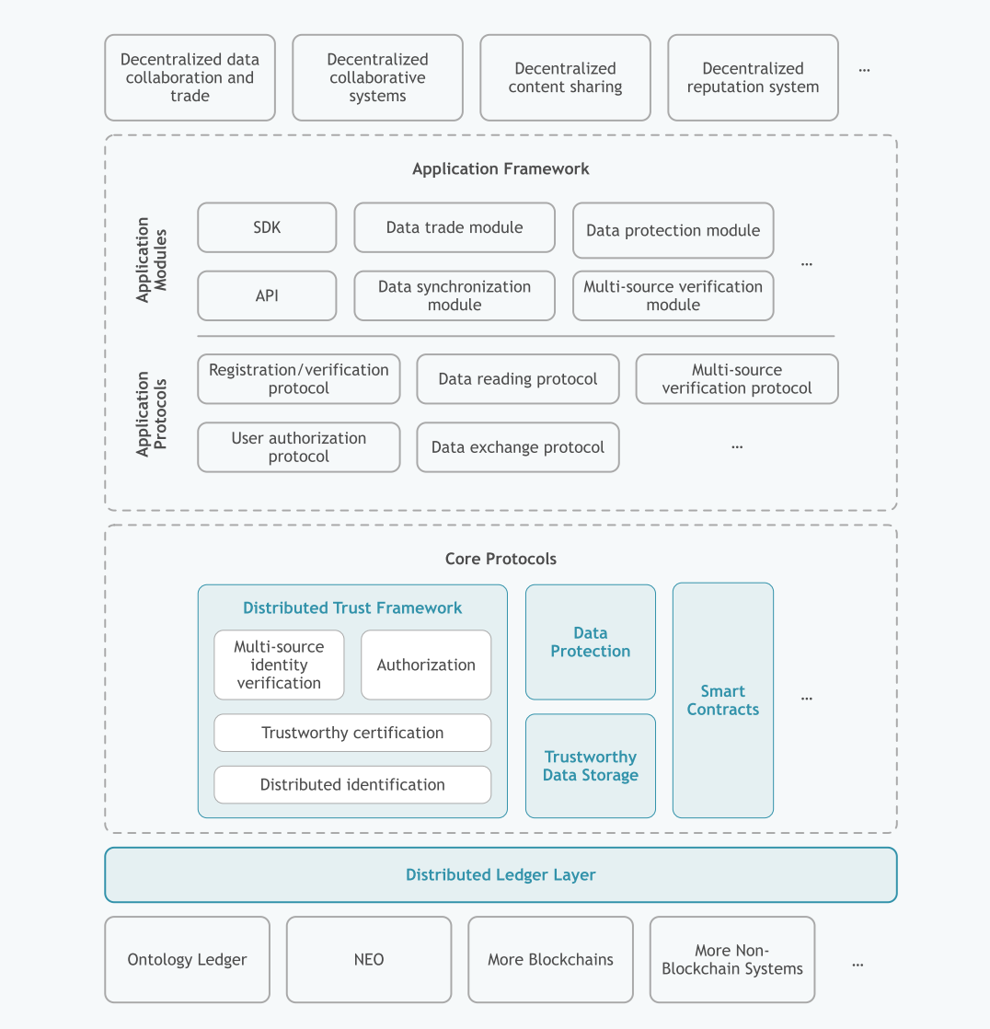
Complete distributed ledger system
Support for major protocols
Support for application development
Application frameworks

Slide 23
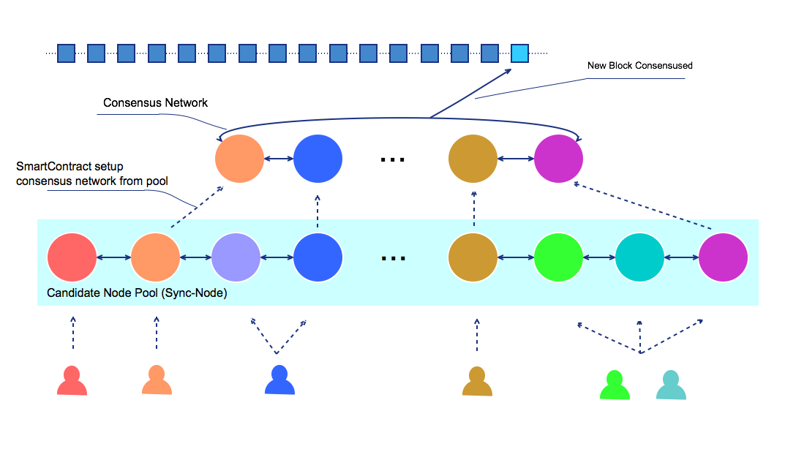
Consensus Network

